Slide 1

CE40-443/1 Computer Networks Programmable Networks
Arshiya Rezaie
Spring 2021
https://github.com/arshiarezaei/course-net
Notes:
Slides adapted from Nick McKeown’s talk and P4 tutorial.

Slide 2
Today, we will take a peek at the forefront of contemporary computer networking research…
An exciting journey
One of the hottest topic in today’s networking research
Yet, might be a little overwhelming
Don’t worry if you do not fully understand it
Raise your hand and ask questions

Slide 3
Agenda
Programmable Networks
Tutorial on Assignment 2

Slide 4
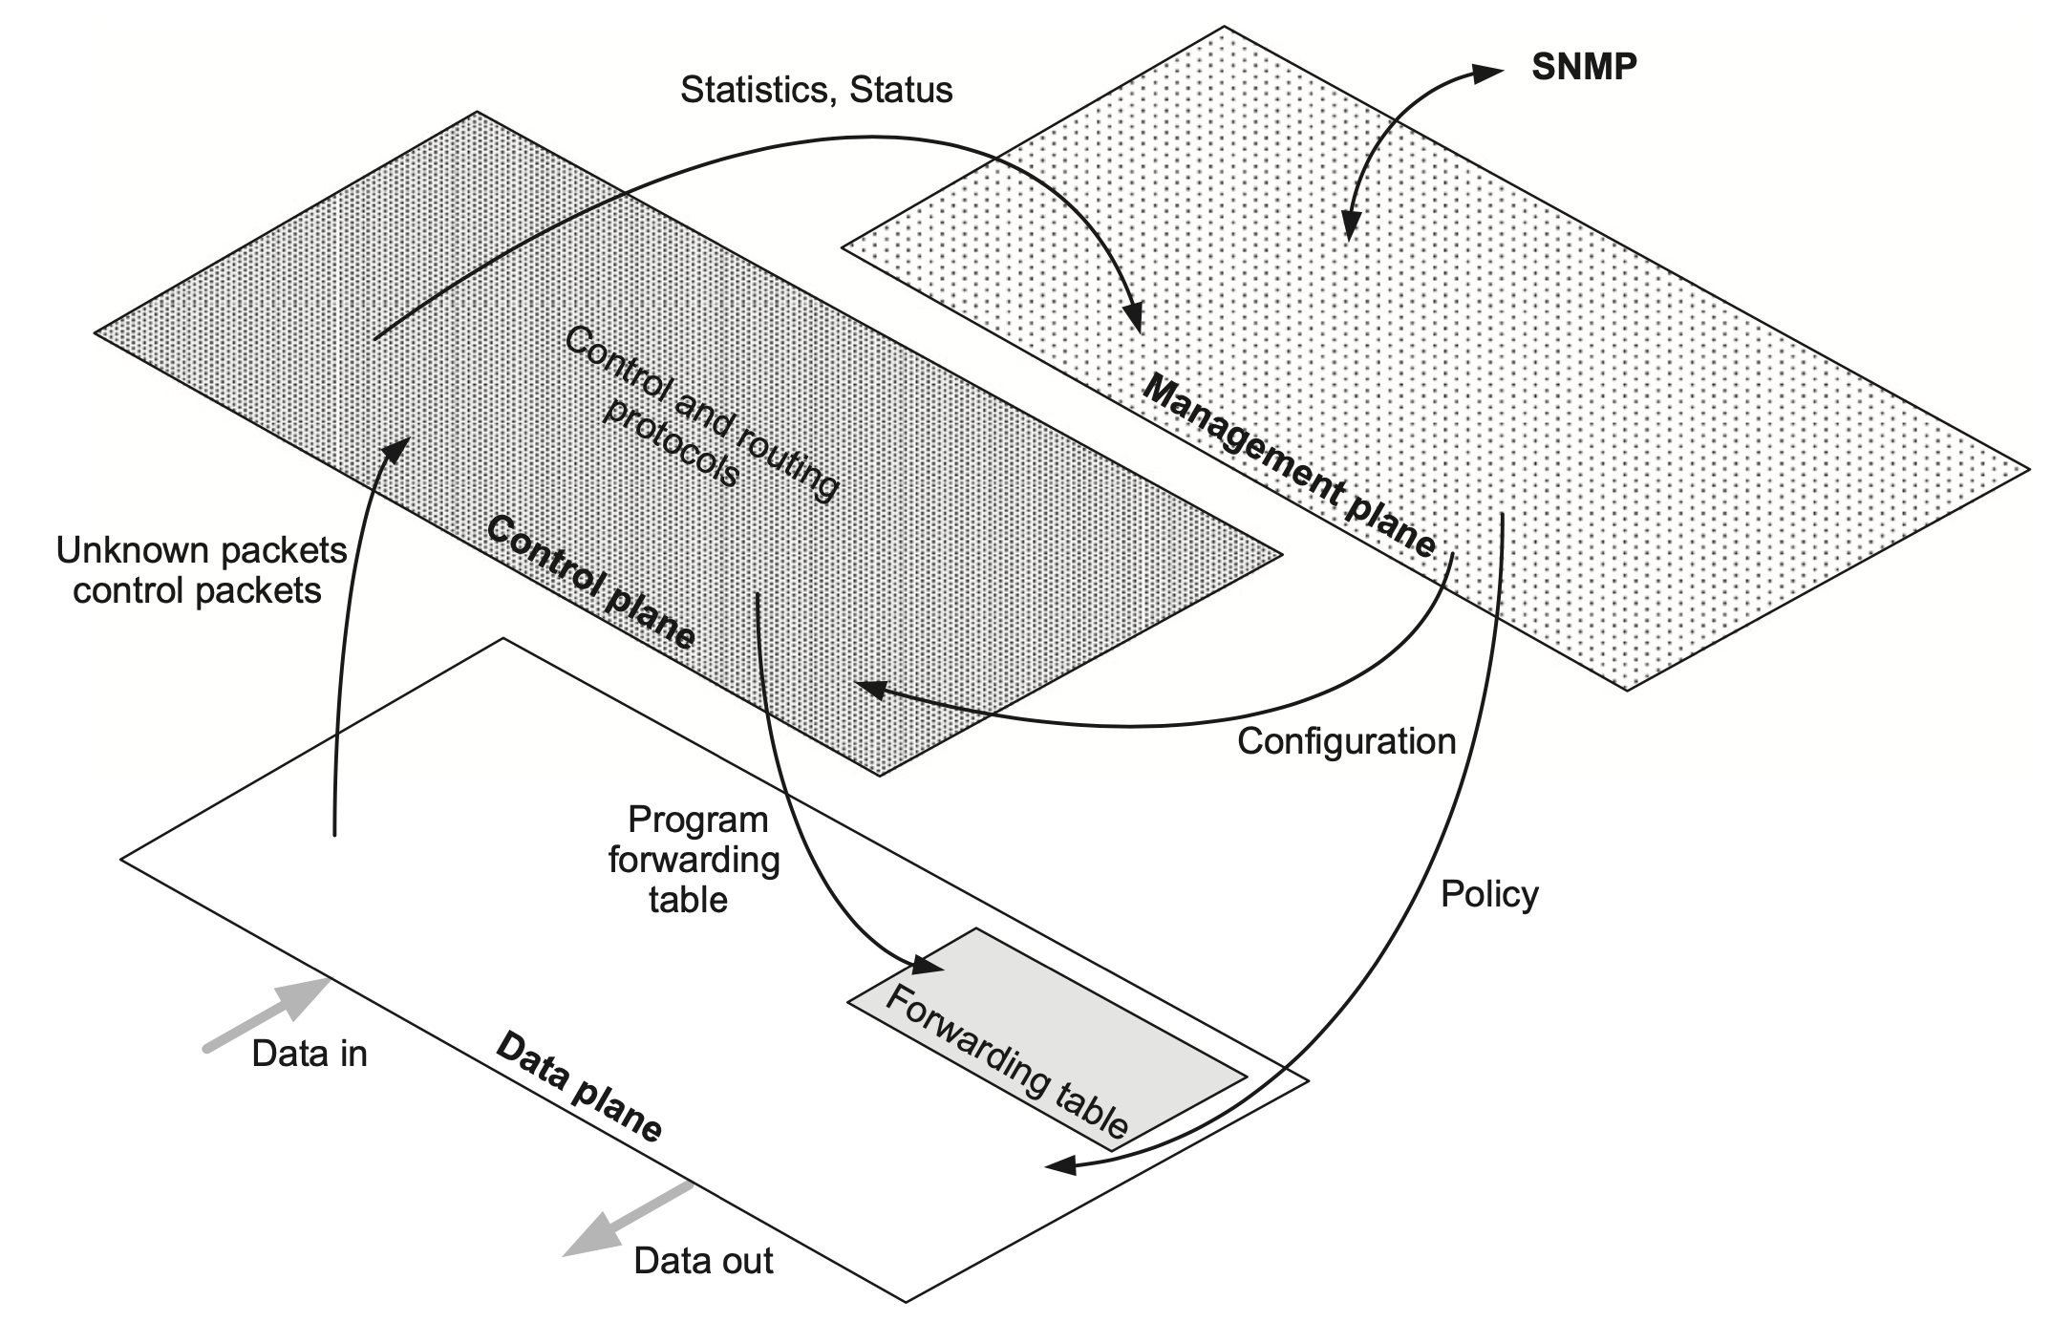
Recap: Forwarding vs. routing
Forwarding: “data plane”
Directing one data packet
Each router using local routing state
Routing: “control plane”
Computing the forwarding tables that guide packets
Jointly computed by routers using a distributed algorithm
Very different timescales!
[Software Defined Networks: A Comprehensive Approach, second edition]
Notes:
Software Defined Networks: A Comprehensive Approach

Slide 5
Recap: Forwarding
To SUT (10.0.0.0/24)
DATA
DstIP=
10.0.1.1
To MIT (10.0.1.0/24)
#1
#2
Forwarding Table @ #0
Dst IP | Next Hop
10.0.0.0/24 | 1
10.0.1.0/24 | 2
10.0.2.0/24 | 3
10.0.3.0/24 | 4
#0
#6
#4
#3
To UCB (10.0.2.0/24)
To NYU (10.0.3.0/24)

Slide 6

Many functionalities in the data plane
IP Prefix Forwarding
Access Control
Load Balancing
Traffic Measurement
and more …...

Slide 7
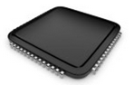
OSPF
BGP
etc.
Switch OS
Driver
Notes:
But first, I’d like to start with a cartoon picture that I’ve used many times, to motivate why programmable forwarding planes change how we think about building networking systems.
This is a cartoon picture of the insides of an enterprise switch or router. It runs a switch OS – which today is almost always based on Linux or BSD Unix.
The Switch OS talks to the switch ASIC via a Driver.
For every protocol and feature, there is a user-level process that exchanges routing table information with neighboring switches.
Today, this is pretty much how all network switches and routers are built.

Slide 8
OSPF
BGP
VXLAN
etc.
Switch OS
Driver
Notes:
Now imagine it’s 2010, and customers are asking for VXLAN. VXLAN was a new way to tag packets in virtualized data centers to identify the tenant the packets belong to.
The equipment vendor needs to write the VXLAN software to control the switch; and they need to update the driver to be able to add and delete entries in the switch ASIC.
This is a few weeks or at most a few months work.
They also need to update the switch ASIC, because VXLAN requires processing packets in new ways, and requires new lookup tables.
In the case of VXLAN, updating the switch ASIC took 4 years!
That’s right, it took 4 years to show up in the switch chips used to build switches and routers.
Let’s remember, this isn’t for some niche low priority feature.
This was in the most profitable, most invested-in part of networking.

Slide 9
Feature
Software
Team
Feature
Network Owner
Network Equipment Vendor
Weeks
Feature
ASIC
Team
Years
Years
Notes:
Let’s think about what happens during those 4 years: First, the network owners have to identify the problem. They tell network equipment vendors like Cisco, Arista, Juniper, who then huddle at the IETF to figure out a solution and publish a new Internet RFC. They define the feature and the software team writes the software – perhaps a few weeks work.
But the chip takes much longer. The ASIC team or the ASIC vendor need to believe the RFC is stable and commercially viable, to risk investing 10s of millions of dollars building a new ASIC.
Then they start to design a new chip with the new feature. 2-3 years later the new feature is available.
And then finally, after all this time, if we want to get the new feature, we have to buy new network equipment.

Slide 10
When you need a new feature…
Equipment vendor can’t just send you a software upgrade
New forwarding features take years to develop
By then, you’ve figured out a kludge to work around it
Your network gets more complicated, more brittle
Eventually, when the upgrade is available, it either
No longer solves your problem, or
You need a fork-lift upgrade, at huge expense.

Slide 11

Network systems are built “bottoms-up”
Switch OS
Driver
“This is how I process packets …”
Fixed-function switch

Slide 12
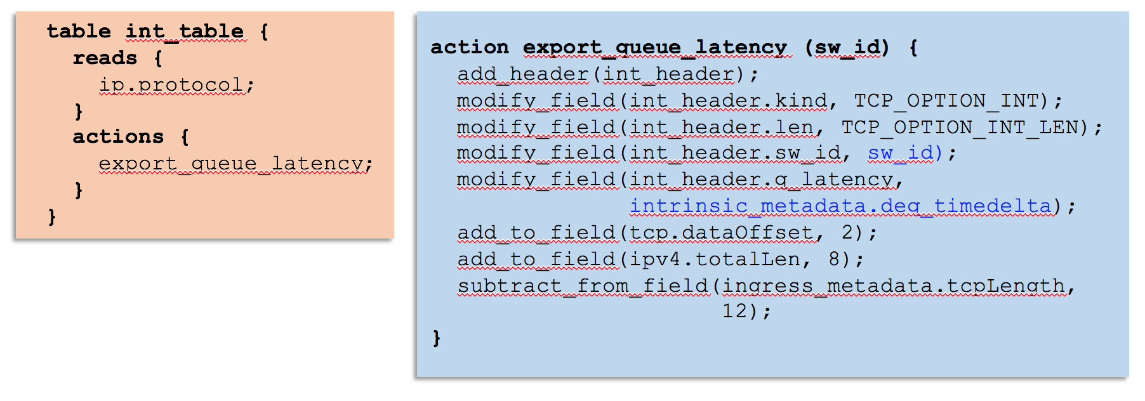
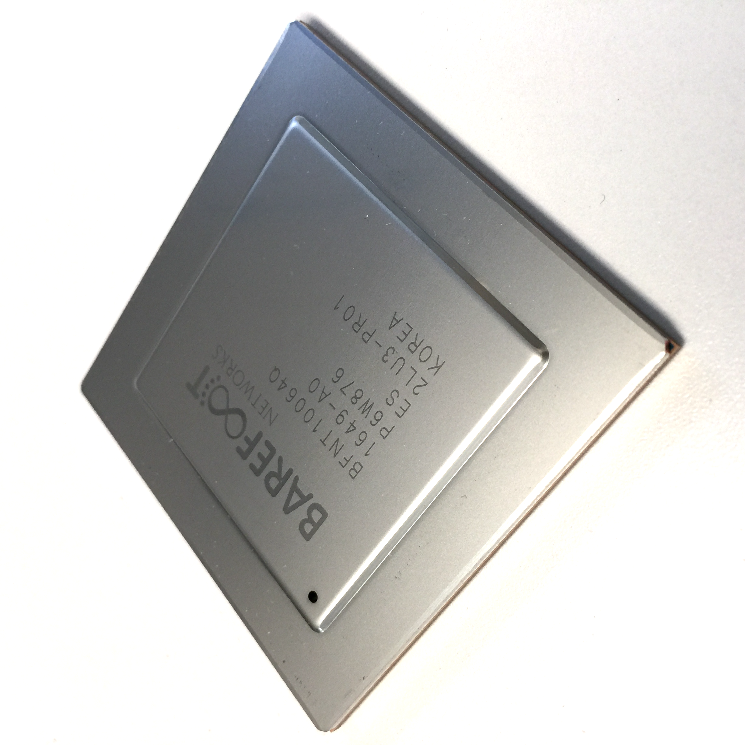
Network systems are starting to be programmed “top-down”
“This is precisely how you must process packets”
Switch OS
Driver
Programmable Switch
Notes:
And so one way to think about what the P4 movement is doing – is to turn the way we design network systems on its head. Our goal is to enable anyone who builds network systems to program the system “top-down”, by telling the forwarding plane precisely the behavior they want. Just like I can do on my computer.
It seems kind of obvious that this is what we want to do. So it begs a question: Why weren’t they all built this way?

Slide 13
Outline
Why programmability is happening now
How programmability is being used
Subtract features: Reducing complexity
Add proprietary features: Invent, differentiate, own
Silicon independence: Breaking a lock-in
Telemetry and measurement
Why programmability now from an ASIC technology viewpoint

Slide 14

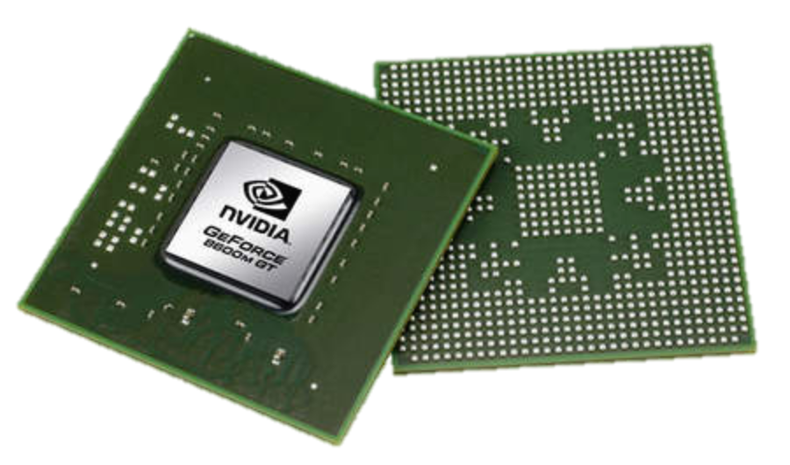
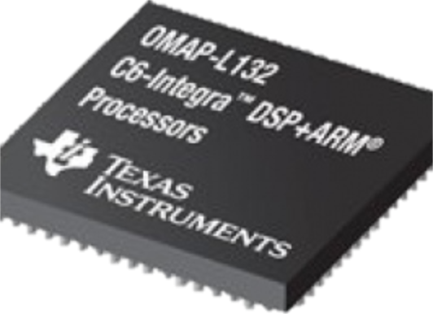
Domain Specific Processors
Signal
Processing
Machine
Learning
Computers
Graphics
Networking
Java
OpenCL
Matlab
TensorFlow
>>>
Language
Compiler
Compiler
Compiler
Compiler
Compiler
?
?
CPU
GPU
DSP
TPU
Notes:
One big reason is that networking has been kind of living in the dark ages, and is only now catching up with other areas of the industry.
Other domains solved this problem by designing their own domain-specific processors. I’m old enough to remember big fixed function graphics cards from folks like Sun, DEC and HP. Today, graphics is done in domain specific processors called GPUs. <show GPU>.
And I remember when signal processing for base-stations and video codecs was built using fixed function hardware. Today, it’s done in digital signal processors or DSPs. <show DSP>
In both cases, the user writes an application in a high level easy to use language, which is compiled down to run on the domain specific processor with the right instruction set, and the right model of parallelism.
The same thing is happening now in machine learning with TPUs <show TPU>.
This hasn’t happened in networking, because no-one stepped back and asked how to build the right domain-specific processor for processing packets.

Slide 15
Domain Specific Processors
Signal
Processing
Machine
Learning
Computers
Graphics
Networking
Java
OpenCL
Matlab
TensorFlow
>>>
P4
Compiler
Compiler
Compiler
Compiler
Compiler
?
CPU
GPU
DSP
TPU
PISA

Slide 16
Many functionalities in the data plane
IP Prefix Forwarding
Access Control
Load Balancing
Traffic Measurement
and more …...

Slide 17
Data plane functionalities have a common style: match-action packet processing
IP Prefix Forwarding
Access Control
Load Balancing
Match | Action
DstIP = 10.0.0.0/24 | fwd(1)
DstIP = 10.0.1.0/24 | fwd(2)
DstIP = 10.0.2.0/24 | fwd(3)
DstIP = 10.0.3.0/24 | fwd(4)
Match | Action
DstPort = 80 | drop
DstIP = 10.0.0.1 | drop
DstIP = 10.0.0.0/24 | pass
DstIP = 10.0.0.0/16 | drop
Match | Action
DstIP = 10.0.0.10 | DstIP = random(10.0.0.1, 10.0.0.2)
DstIP = 10.0.1.10 | DstIP = random(10.0.1.1, 10.0.1.2)
10.0.0.1
DATA
DstIP=
10.0.0.10
10.0.0.2

Slide 18
PISA: Protocol Independent Switch Architecture
Programmer declares which
headers are recognized
Programmer declares what
tables are needed and how packets are processed
Match+Action
Memory
ALU
Programmable
Parser
All stages are identical – makes PISA a good “compiler target”
Notes:
PISA chips are also built around a pipeline. But in PISA, all the pipeline stages are all IDENTICAL. They initially don’t know anything about protocols – they are sitting waiting to receive instructions from the compiler.
The basic operations of each stage is called “Match + Action” – In each stage, there is a set of memories which match on headers,
Depending on the match, an action is applied to the header by an ALU. And then the header is passed to the next stage, and so on.
A PISA chip is initially blank – it doesn’t know about any protocols.
The P4 programmer tells the programmable parser what packet headers it should recognize.
If a new header is developed, we add it to the set of headers the parser recognizes.
Let’s take a closer look at how a packet is processed …..

Slide 19
PISA: Protocol Independent Switch Architecture
Programmable
Parser

Slide 20
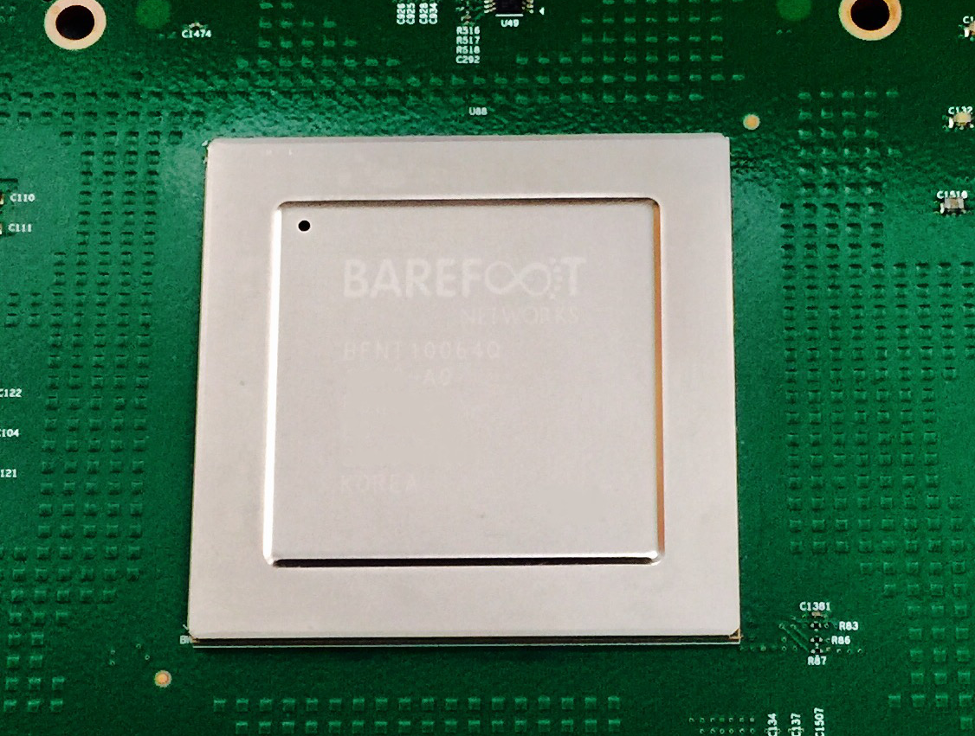
Tofino 6.5Tb/s Switch December 2016
65 x 100GE (or 260 x 25GE)
Same power and cost as fixed-function switches.

Slide 21
Outline
Why programmability is happening now
How programmability is being used
Subtract features: Reducing complexity
Add proprietary features: Invent, differentiate, own
Silicon independence: Breaking a lock-in
Telemetry and measurement
Why programmability now from an ASIC technology viewpoint

Slide 22
How programmability is being used
Reducing complexity
1

Slide 23
Reducing complexity
switch.p4
Switch OS
Driver
IPv4 and IPv6 routing
- Unicast Routing
- Routed Ports & SVI
- VRF
- Unicast RPF - Strict and Loose
- Multicast
- PIM-SM/DM & PIM-Bidir
Ethernet switching
- VLAN Flooding
- MAC Learning & Aging
- STP state
- VLAN Translation
Load balancing
- LAG
- ECMP & WCMP
- Resilient Hashing
- Flowlet Switching
Fast Failover
– LAG & ECMP
Tunneling
- IPv4 and IPv6 Routing & Switching
- IP-in-IP (6in4, 4in4)
- VXLAN, NVGRE, GENEVE & GRE
- Segment Routing, ILA
MPLS
- LER and LSR
- IPv4/v6 routing (L3VPN)
- L2 switching (EoMPLS, VPLS)
- MPLS over UDP/GRE
ACL
- MAC ACL, IPv4/v6 ACL, RACL
- QoS ACL, System ACL, PBR
- Port Range lookups in ACLs
QOS
- QoS Classification & marking
- Drop profiles/WRED
- RoCE v2 & FCoE
- CoPP (Control plane policing)
NAT and L4 Load Balancing
Security Features
- Storm Control, IP Source Guard
Monitoring & Telemetry
Ingress Mirroring and Egress Mirroring
Negative Mirroring
Sflow
INT
Counters
Route Table Entry Counters
VLAN/Bridge Domain Counters
Port/Interface Counters
Protocol Offload
- BFD, OAM
Multi-chip Fabric Support
- Forwarding, QOS
Compiler
Programmable Switch

Slide 24
Reducing complexity
My switch.p4
Switch OS
Driver
Compiler
Programmable Switch

Slide 25
How programmability is being used
Adding proprietary features
2

Slide 26
Protocol complexity 20 years ago
Ethernet
ethtype
ethtype
IPv4
IPX
Notes:
Back in the 1990s, a switch chip only needed to support 2 or 3 protocols.

Slide 27
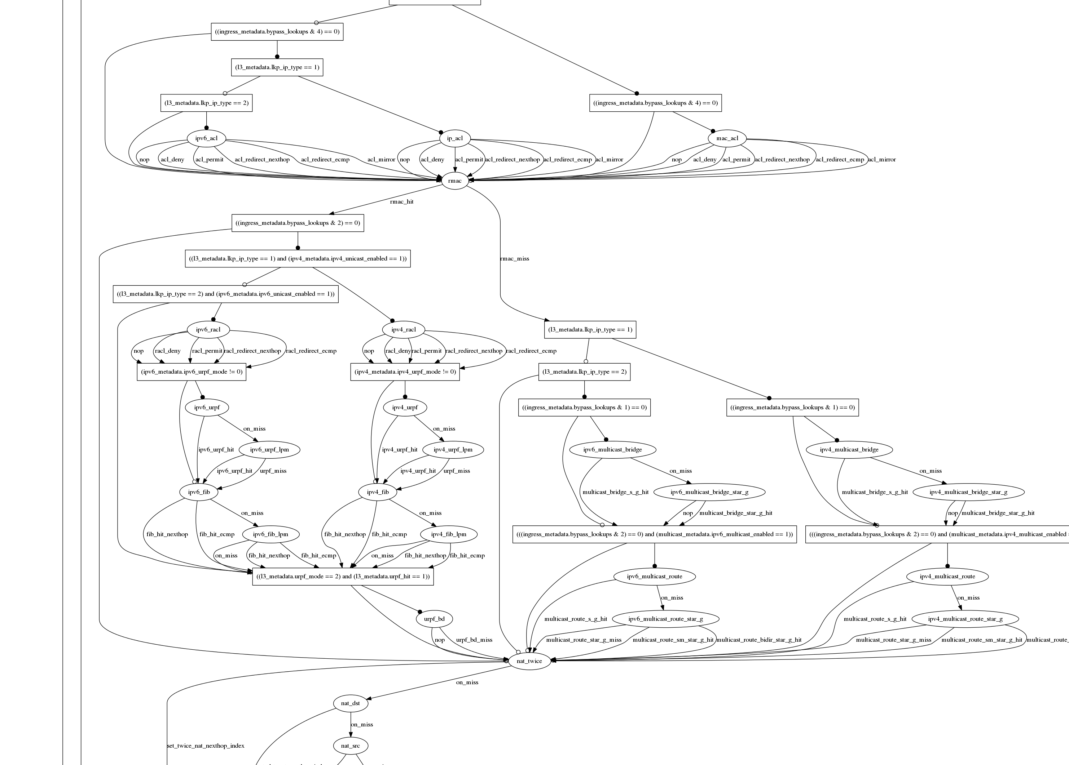
Datacenter switch today
switch.p4
Notes:
Today, it needs to support dozens. This is the typical set of protocols supported in a data center top of rack switch today. It is getting almost impossible to design fixed function chips with all the protocols, and to get it right.
If the chip is programmable, the chip design is much simpler. Complicated protocols are just programs written later by the user.
You can see how switch chips get more uniform as they become more programmable.

Slide 28
Adding features: Some examples so far
New encapsulations and tunnels
New ways to tag packets for special treatment
New approaches to routing: e.g. source routing in MSDCs
New approaches to congestion control
New ways to process packets: e.g. processing ticker-symbols

Slide 29
New applications: Some examples so far
Layer-4 Load Balancer¹
Replace 100 servers or 10 dedicated boxes with one programmable switch
Track and maintain mapping for 5-10 million http flows
Fast stateless firewall
Add/delete and track 100s of thousands of new connections per second
Cache for Key-value store²
Memcache in-network cache for 100 servers
1-2 billion operations per second
[1] “SilkRoad: Making Stateful Layer-4 Load Balancing Fast and Cheap Using Switching ASICs.” Rui Miao et al. Sigcomm 2017.
[2] “NetCache: Balancing Key-Value Stores with Fast In-Network Caching”, Xin Jin et al. To appear at SOSP 2017

Slide 30
How programmability is being used
Silicon independence
3

Slide 31
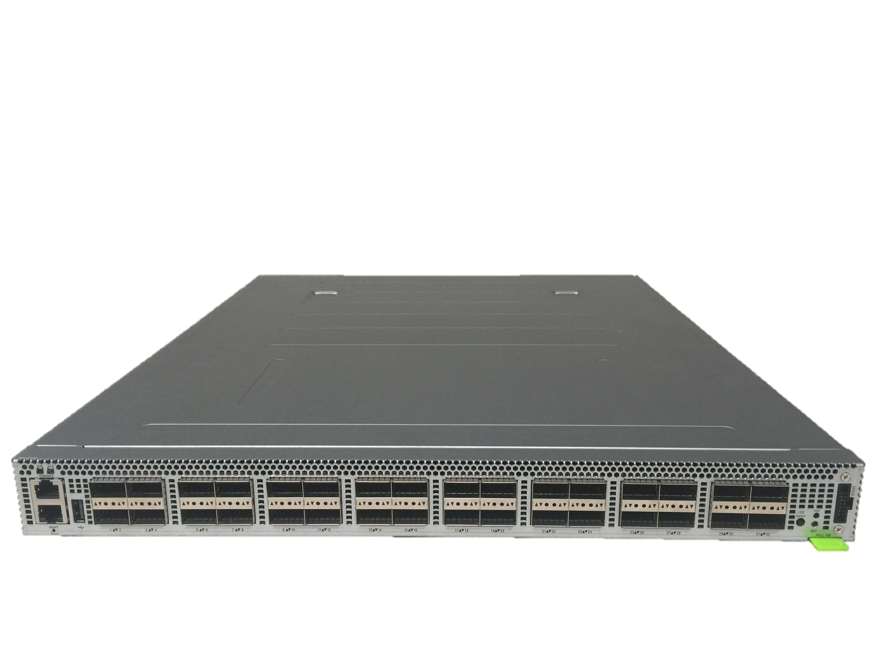
P4 Runtime Open-source project to remotely control P4 switches¹
Remote Control Plane
P4 Runtime
P4 Runtime
P4 Runtime
P4 Runtime
P4 Runtime API is:
Silicon Independent
Program Independent
OpenConfig
OpenConfig
OpenConfig
OpenConfig
gRPC
gRPC
gRPC
gRPC
Top of Rack
P4 Switches
P4 Runtime
P4 Runtime
P4 Runtime
P4 Runtime
Switch OS
Switch OS
Switch OS
Switch OS
[1] “P4 Program-dependent Controller Interface for SDN Applications”, Samar Abdi et al (Google), P4 Workshop 2017

Slide 32
How programmability is being used
Network telemetry
4

Slide 33
“I visited Switch 1 @780ns, Switch 9 @1.3µs, Switch 12 @2.4µs”
1
“Which path did my packet take?”
# | Rule
1
2
3
…
75 | 192.168.0/24
…
“In Switch 1, I followed rules 75 and 250. In Switch 9, I followed rules 3 and 80. ”
2
“Which rules did my packet follow?”
Notes:
But if we want to have complete visibility into exactly what our network is doing, all the time, then we need to answer four questions.
First: Which path did my packet take? I want every packet to tell me which switches it visited and when, to the nanosecond.
Second: When it passed through the switches, which rules did it match on? I want every packet to tell me which rules it matched on along the way, so I can tell exactly why it reached this point.

Slide 34
3
“How long did my packet queue at each switch?”
“Delay: 100ns, 200ns, 19740ns”
Queue
4
“Who did my packet share the queue with?”
Time
Notes:
Third: How long did my packet spend in the queue at each switch along the way? I want every packet to tell me how long it was sitting in a queue, to the nanosecond.
In this case, we can see that the queue spent a long time in the 3rd switch, which must be because of congestion. I need to know who caused the congestion, so I want to have the switch tell me. This leads to my final question:
“Who did my packet share the queue with?”

Slide 35
3
“How long did my packet queue at each switch?”
“Delay: 100ns, 200ns, 19740ns”
Aggressor flow!
Queue
4
“Who did my packet share the queue with?”
Time
Notes:
Once I know who I shared the queue with, and I can see that all these orange packets are causing congestion, I can identify the flow, the application, the server and the real culprit.

Slide 36
We’d like the network to answer these questions
“Which path did my packet take?”
“Which rules did my packet follow?”
“How long did it queue at each switch?”
“Who did it share the queues with?”
1
2
3
4
A programmable device can potentially answer all four questions at line rate.
Notes:
Let’s summarize the four questions. These are the holy grail of network monitoring: They represent the complete ground truth of what’s happening in the network.
This information has never been available before in a network in the history of networking, because most people consider it too hard to capture.

Slide 37
INT: Inband Network Telemetry
Add: SwitchID, Arrival Time, Queue Delay, Matched Rules, …
Original Packet
Log, Analyze
Replay
Visualize

Slide 38
/* INT: add switch id */
action int_set_header_0() {
add_header(int_switch_id_header);
modify_field(int_switch_id_header.switch_id,
global_config_metadata.switch_id);
}
/* INT: add ingress timestamp */
action int_set_header_1() {
add_header(int_ingress_tstamp_header);
modify_field(int_ingress_tstamp_header.ingress_tstamp, i2e_metadata.ingress_tstamp);
}
/* INT: add egress timestamp */
action int_set_header_2() {
add_header(int_egress_tstamp_header);
modify_field(int_egress_tstamp_header.egress_tstamp,
eg_intr_md_from_parser_aux.egress_global_tstamp);
}
P4 code snippet: Insert switch ID, ingress and egress timestamp
Log, Analyze
Replay
Visualize

Slide 39
Outline
Why programmability is happening now
How programmability is being used
Subtract features: Reducing complexity
Add proprietary features: Invent, differentiate, own
Silicon independence: Breaking a lock-in
Telemetry and measurement
Why programmability now from an ASIC technology viewpoint

Slide 40
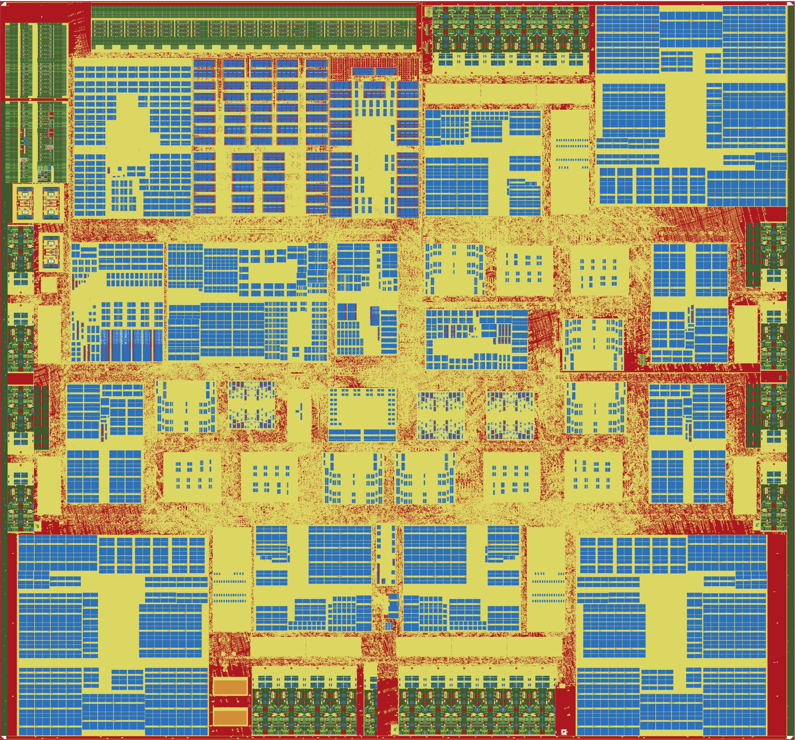
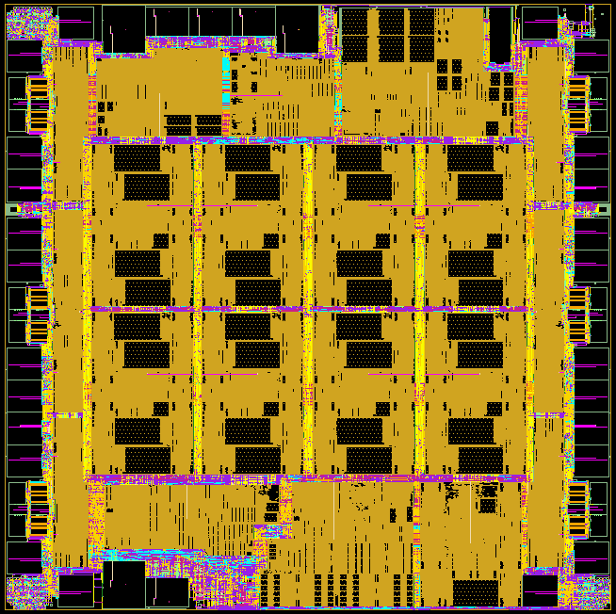
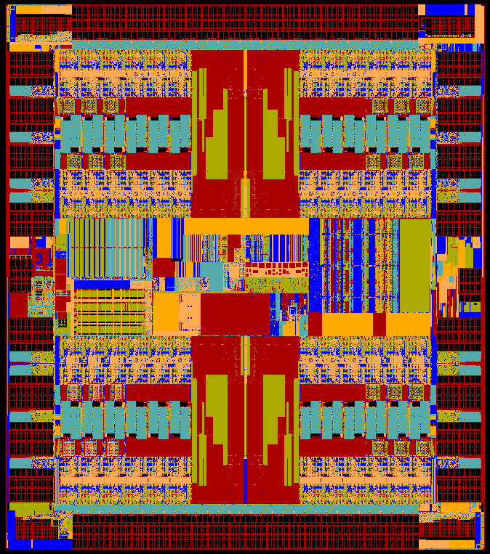
Serial I/O: About 30% of switch chip area
Intel Alta (2011)
Cisco (2011)
Ericsson Spider (2011)
Broadcom Tomahawk (2014)
Barefoot Tofino (2016)
Notes:
First, about 30% of the chip area is devoted to serial I/O. Here we have three switch chips from 2011 with the serial I/O round the edge <click> . It’s about the same for more recent chips too.

Slide 41
Switch chip area: Serial I/O
Serial I/O
Same area for each generation
1.0
Area stays same
Area stays same
Moore’s Law
Moore’s Law
Double Speed
Double Speed
Silicon
Area
Normalized
0.5
k
k+1
k+2
Semiconductor generation
Notes:
This is because with each new generation Moore’s Law lets us halve the size, but then we double the speed, which cancels it out. The same in the next generation and so on. Serial I/O has the same area for each generation.

Slide 42
30% Serial I/O
50%
Packet Processing
20%
Packet Buffer
& TM
Notes:
50% of the chip is devoted to packet processing, and about 20% to the packet buffer & TM.

Slide 43
30% Serial I/O
Packet Processing
25% Memory
(Lookup tables)
20%
Packet Buffer
& TM
25% Logic
(Packet Processing)
Notes:
Packet processing is split in turn, equally between lookup table memory and Logic. So what happens over each generation to the lookup tables and the packet buffers?

Slide 44
Switch chip area: Memory (Tables and Buffer)
Memory
Same area for each generation
1.0
Area stays same
Area stays same
Moore’s Law
Moore’s Law
Double Storage
Double Storage
Silicon
Area
Normalized
0.5
k
k+1
k+2
Semiconductor generation
Notes:
It stays the same too. In each generation Moore’s Law halves the memory area, but we always increase the capacity of tables and buffers, which cancels it out. It’s the same in the next generation. Memory area is the same for each generation.

Slide 45
30% Serial I/O
Packet Processing
25% Memory
(Lookup tables)
20%
Packet Buffer
& TM
Logic dictates whether “fixed function” or “programmable”
25% Logic
(Packet Processing)
Notes:
Now, and this is important, notice that the red portion - the Logic - is the only part of the chip that is different between fixed function and programmable. The lookup tables, packet buffer and serial I/O are all unaffected by whether the chip is fixed or programmable.

Slide 46
Switch chip area: Packet Processing Logic
1.0
Area goes down
Moore’s Law
Silicon
Area
Normalized
10% new features
0.5
Area goes down
Logic
Area goes down each generation
Moore’s Law
10% new features
k
k+1
k+2
Semiconductor generation
Notes:
So what happens to the Logic over time - does it stay the same too? No. It gets smaller. That’s because the number of protocols stays about the same from one generation to the next, and Moore’s Law shrinks it.
Logic area goes down each generation.

Slide 47
30% Serial I/O
Packet Processing
25% Memory
(Lookup tables)
20%
Packet Buffer
& TM
Logic dictates whether “fixed function” or “programmable”
25% Logic
(Packet Processing)
Notes:
This means in each generation, the fraction of the chip that’s Logic goes down.

Slide 48
30% Serial I/O
Memory
(Lookup tables)
Packet Processing
Packet Buffer
& TM
Logic dictates whether “fixed function” or “programmable”
Logic
(Packet Processing)
Notes:
Eventually, there is really no difference between a fixed function chip and a programmable chip.

Slide 49
30% Serial I/O
Memory
(Lookup tables)
Packet Processing
Packet Buffer
& TM
Logic dictates whether “fixed function” or “programmable”
Logic
(Packet Processing)
Notes:
In other words, a programmable chip has the same power and area - and hence the same cost as a fixed function switch.
There’s another reason too. Programmable chips are easier to design and easier to verify. Although the number of protocols only grows about 10% each generation, over many generations this adds up.

Slide 50
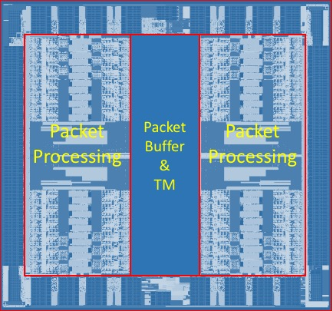
Programmable switch chips are more uniform
Cisco
Intel Alta
Ericsson Spider
Barefoot Tofino
More programmable
Notes:
Notice how much more uniform they became. It means a more compact and efficient design, and a design that’s easier to verify.
So let me summarize why the forwarding plane will be programmable in future:

Slide 51
In summary
Chip speed: We can now make programmable switch chips as fast as fixed ones.
Chip technology: The difference in chip area and power between “programmable” and “fixed function” is going away.
Chip complexity: There are now too many protocols to correctly hard-code in silicon.
New ideas: Beautiful new ideas are owned by the programmer, not the chip designer.
Level playing field: Lets us create a solid platform, an abstraction layer, upon which more will be built
To learn more, visit P4.org
Notes:
Chip technology: The difference in chip area and power between “programmable” and “fixed function” is going away.
Chip complexity: There are now too many protocols to correctly hard-code in silicon.
Chip architecture: Instruction set is now known.
Chip speed: We can now make programmable switch chips as fast as fixed ones.
New ideas: Beautiful new ideas are owned by the programmer, not the chip designer.
More reliable network: Greater visibility means failures diagnosed faster. Fixes deployed quickly.

Slide 52
Agenda
Programmable Networks
Tutorial on Assignment 2

Slide 53
Tutorial on Assignment 2
Exercise 1 : Mininet
Exercise 2: Access control list (ACL)
Write P4 code to implement access control list (acl.p4)
Add rules to your table to block certain destination port and IP (s1-acl.json)
Exercise 3: Load balancing
Write P4 code to implement load balancing (lb.p4)
Add rules to your table to block certain destination port and IP (s1-lb.json)

Slide 54
PISA: Protocol-Independent Switch Architecture
Programmer defines the tables and the exact processing algorithm
Programmer declares how the output packet will look on the wire
Programmer declares the headers that should be recognized and their order in the packet
Programmable Match-Action Pipeline
Programmable Parser
Programmable Deparser
Notes:
In order to design a programming language, it is very useful to settle on the abstract machine, that is suited for the algorithms we'd like to express.
P4 is based on the abstract model of a high-speed packet processing device, called PISA, which stands for Protocol-Independent Switch Architecture.
PISA incorporates four basic components:
First, it is a programmable parser, which determines, which packet headers will be recognized by the data plane program. It is modeled as a simple, deterministic state machine, that consumes packet data and identifiers headers. It transitions between states typically by looking at specific fields in the previously identified headers. For example: The first 14 bytes are an Ethernet header. Then, if you look at the Ethertype, you know that the next header is a VLAN tag, an IPv4 or IPv6 header, an MPLS label, etc. If a parser identified an IPv4 header, it can jump to the next state based on IP protocol and so on.
At the heart of the PISA architecture is a pipeline, consisting of a set of “Match-Action” stages. What they can do is to match some data against a table that contains some entries and execute a corresponding action. If you think about it, that’s pretty much all the networking devices do. For example, an L2 switch will use a Destination MAC address (and a VLAN) to perform a match in an L2 table and then execute an action, such as “send a packet to this egress port”. Similarly, L3 switching is also easily reduced to a sequence of matches, such as Destination IP address lookup will produce a NexthopID and a lookup on a Nexthop ID will produce actions, such as “send to port”, “change MAC address”, “decrement TTL”, etc. ACLs, MPLS switching, everything can be expressed this way. Even basic things like if() or switch() statements can also be reduced to the basic operation of match and Action.
At the end of the pipeline, there is a programmable deparser that performs (as its name says)the operation, which is a reverse of the parsing. It re-assembles the packets back (e.g., by serializing the headers) so that the packets can go back onto the wire, into the queueing/replication engine etc.

Slide 55
PISA in Action
Packet is parsed into individual headers (parsed representation)
Headers and intermediate results can be used for matching and actions
Headers can be modified, added or removed
Packet is deparsed (serialized)
Programmable Match-Action Pipeline
Programmable Parser
Programmable Deparser
Notes:
The way PISA operates is quite straightforward (both figuratively and literally).
First, a packet arrives at the parser, which splits it into the individual headers, according to the parser program.
Then the parsed headers are passed into the match-action pipeline that matches either the headers or the intermediate results against match-action tables and performs a variety of operations:
For example it can remove or add headers
It can freely move the data between the headers, the intermediate results and the device state (represented here as tables)
It can perform both simple arithmetic and more specialized operations
Last, the deparser serializes the remaining headers back into the packet byte-stream

Slide 56
P4₁₆ Language Elements
Parsers
State machine, bitfield extraction
Controls
Tables, Actions, control flow statements
Expressions
Basic operations and operators
Data Types
Bistrings, headers, structures, arrays
Architecture Description
Programmable blocks and their interfaces
Extern Libraries
Support for specialized components
Notes:
P4 programs are composed of various different components
Parsers and controls are the main programmable blocks that you describe in P4
Parsers are implemented as a state machine and their sole purpose is to extract header fields from the packet in some user-defined way
Controls are responsible for the main match-action processing. This is where you define and apply your tables and actions to manipulate packet headers and metadata
The implementation of these parsers and control blocks is provided by the P4 programmer; they are built using the various data types and expressions defined in the language
On the other hand, the orange boxes listed here are provided by the vendor of the P4 programmable target.
The architecture description specifies a particular configuration of programmable parsers, control blocks, and perhaps vendor specific blocks.
The vendor may also provide a library of what we call “Externs”. Externs provide some functionality that is not implemented in P4, but provide an interface such that can interact with or be invoked by P4 programs. The P4 developer can think of them as black boxes. Externs may be specific to a particular target, but different targets may in fact support externs that provide the same interface and functionality, which facilitates portability of P4 programs.
Let’s now look at the specific architecture that we will be using for this tutorial, the V1Model.

Slide 57
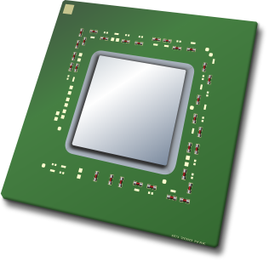
Programming a P4 Target
User supplied
Control Plane
P4 Program
P4 Compiler
Add/remove table entries
Extern control
Packet-in/out
RUNTIME
CPU port
P4 Architecture
Model
Data Plane
Target-specific configuration binary
Tables
Extern
objects
Load
Target
Vendor supplied

Slide 58
V1Model Architecture
Implemented on top of Bmv2’s simple_switch target
Bmv2 is a software switch that can run on your laptop
Parser
Checksum Verification / Ingress Match-Action
Checksum Update / Egress Match-Action
Deparser
Traffic
Manager
Notes:
The V1Model architecture is implemented on top of the Bmv2’s simple_switch target.
For those that don’t know, the Bmv2 simple_switch is a software switch developed by P4.org for testing the functionality of P4 programs. The V1Model is by no means the only architecture that can be supported by Bmv2, but it is the one that we will use today.
It consists of a P4 programmable parser and deparser, a block to verify checksums on incoming packets, a block to update checksums on outgoing packets, separate ingress and egress pipelines of match-action processing, as well as a traffic manager. The traffic manager is not currently programmable in P4 but performs the task of scheduling and sometimes replicating packets between the input and output ports.
The architecture description also includes a set of standard metadata fields that are used by the P4 program to direct the packet through the Bmv2 simple_switch.
label elements
**** Alternative ****
It consists of the following components:
A programmable parser to extract the packet headers in some P4 defined way
A programmable deparser at the end to reconstruct the packet as specified in the P4 program
Separate blocks to verify checksums on incoming packets and update checksums on outgoing packets
An ingress pipeline of match-action processing which is used to ...
An egress pipeline of match-action processing allowing the P4 program to modify a packet based on the port it is departing from
And a traffic manager which is not currently programmable in P4 but performs the task of scheduling and sometimes replicating packets between the input and output ports

Slide 59
P4₁₆ Program Template (V1Model)
#include <core.p4>
#include <v1model.p4>
/* HEADERS */
struct metadata { ... }
struct headers {
ethernet_t ethernet;
ipv4_t ipv4;
}
/* PARSER */
parser MyParser(packet_in packet,
out headers hdr,
inout metadata meta,
inout standard_metadata_t smeta) {
...
}
/* CHECKSUM VERIFICATION */
control MyVerifyChecksum(in headers hdr,
inout metadata meta) {
...
}
/* INGRESS PROCESSING */
control MyIngress(inout headers hdr,
inout metadata meta,
inout standard_metadata_t std_meta) {
...
}
/* EGRESS PROCESSING */
control MyEgress(inout headers hdr,
inout metadata meta,
inout standard_metadata_t std_meta) {
...
}
/* CHECKSUM UPDATE */
control MyComputeChecksum(inout headers hdr,
inout metadata meta) {
...
}
/* DEPARSER */
control MyDeparser(inout headers hdr,
inout metadata meta) {
...
}
/* SWITCH */
V1Switch(
MyParser(),
MyVerifyChecksum(),
MyIngress(),
MyEgress(),
MyComputeChecksum(),
MyDeparser()
) main;
Notes:
Here is a template for a typical P4 program written for the V1Model
At the top of the file, we must include core.p4 because it defines some of the common types that are used in all P4 programs
<click> We also must include v1model.p4, which provides the definition of the V1Model architecture and also declares the various externs that can be used for this target; such as counters, meters, and registers
<click> A P4 program typically begins by declaring the format of various packet headers and building the headers and metadata structs. These structs are passed from block to block, along with the standard_metadata, as the packet traverses the architecture
Subsequently, the P4 source file (or files) must define the functionality for the parser
<click> checksum verification block
<click> ingress match-action processing
<click> egress match-action processing
<click> checksum update block
<click> deparser
<click> And finally, the P4 program must instantiate an instance of the architecture called main.
Let’s now take a look at the most basic example of a P4 program

Slide 60
P4₁₆ Hello World (V1Model)
#include <core.p4>
#include <v1model.p4>
struct metadata {}
struct headers {}
parser MyParser(packet_in packet,
out headers hdr,
inout metadata meta,
inout standard_metadata_t standard_metadata) {
state start { transition accept; }
}
control MyVerifyChecksum(inout headers hdr, inout metadata meta) { apply { } }
control MyIngress(inout headers hdr,
inout metadata meta,
inout standard_metadata_t standard_metadata) {
apply {
if (standard_metadata.ingress_port == 1) {
standard_metadata.egress_spec = 2;
} else if (standard_metadata.ingress_port == 2) {
standard_metadata.egress_spec = 1;
}
}
}
control MyEgress(inout headers hdr,
inout metadata meta,
inout standard_metadata_t standard_metadata) {
apply { }
}
control MyComputeChecksum(inout headers hdr, inout metadata meta) {
apply { }
}
control MyDeparser(packet_out packet, in headers hdr) {
apply { }
}
V1Switch(
MyParser(),
MyVerifyChecksum(),
MyIngress(),
MyEgress(),
MyComputeChecksum(),
MyDeparser()
) main;
Notes:
This is what I like to call the Hello World example for P4 programs. It is essentially just a wire that connects port 1 to port 2.
For this example, the parser does not need to extract any headers from the packet. It simple accepts and the packet is passed along to MyVerifyChecksum() block, which also does not need to do anything.
<click> When the packet reaches the MyIngress() block, the P4 program checks the port on which the packet arrived by reading the ingress_port field of the standard_metadata bus and decides which port to send the packet to using a simple if, else-if statement.
The rest of the blocks do not need to do anything and at the end of the program we instantiate the switch.
As you can see, all packets that arrives on port 1 will be sent to port 2 and all packets that arrive on port 2 will be sent to port 1
In this example, the connection between port 1 and port 2 is hardcoded and cannot be changed after the P4 program is compiled. Let’s see how we can make the switch a bit more flexible

Slide 61
P4₁₆ Hello World (V1Model)
#include <core.p4>
#include <v1model.p4>
struct metadata {}
struct headers {}
parser MyParser(packet_in packet, out headers hdr,
inout metadata meta,
inout standard_metadata_t standard_metadata) {
state start { transition accept; }
}
control MyIngress(inout headers hdr, inout metadata meta,
inout standard_metadata_t standard_metadata) {
action set_egress_spec(bit<9> port) {
standard_metadata.egress_spec = port;
}
table forward {
key = { standard_metadata.ingress_port: exact; }
actions = {
set_egress_spec;
NoAction;
}
size = 1024;
default_action = NoAction();
}
apply { forward.apply(); }
}
control MyEgress(inout headers hdr,
inout metadata meta,
inout standard_metadata_t standard_metadata) {
apply { }
}
control MyVerifyChecksum(inout headers hdr, inout metadata meta) { apply { } }
control MyComputeChecksum(inout headers hdr, inout metadata meta) { apply { } }
control MyDeparser(packet_out packet, in headers hdr) {
apply { }
}
V1Switch( MyParser(), MyVerifyChecksum(), MyIngress(), MyEgress(), MyComputeChecksum(), MyDeparser() ) main;
Key | Action ID | Action Data
1 | set_egress_spec ID | 2
2 | set_egress_spec ID | 1
Notes:
This design achieves the exact same functionality as what we just saw, but rather than using the if, else-if statement in the MyIngress control block, it uses a single table, called forward.
The forward table matches on the ingress_port field, and can invoke either the set_egress_spec action, or NoAction.
The table entries specify which action to take, along with any input parameters, for different ingress_port values.
We will explain P4 tables in more detail shortly.
By writing our P4 program in this way, we have created a much more flexible switch because now we can add and remove table entries from the control plane to determine how to to route packets between the various ports. And we can do this without changing the P4 program at all.

Slide 62
Example: IPv4_LPM Table
Data Plane (P4) Program
Defines the format of the table
Key Fields
Actions
Action Data
Performs the lookup
Executes the chosen action
Control Plane (IP stack, Routing protocols)
Populates table entries with specific information
Based on the configuration
Based on automatic discovery
Based on protocol calculations
10.0.1.1
10.0.1.2
1
2
Key | Action | Action Data
10.0.1.1/32 | ipv4_forward | port=1
10.0.1.2/32 | ipv4_forward | port=2
* | drop
Notes:
To build our simple IP router, we will need to define a routing table
The routing table must perform a longest prefix match on the destination IP address
Each table entry may invoke either the the ipv4_forward action which updates the packet’s destination MAC address, configures the packet’s egress port, and decrements the TTL, or it may invoke the drop action.
The default will be to perform no action at all.
I want to take a moment to highlight how the data plane and control plane work together to perform IP routing.
The P4 data plane defines the format of the routing table, it specifies fields to match on and possible actions to invoke. It performs the table lookup and executes the chosen action.
The control plane is responsible for populating the table with entries. There may potentially be many different control mechanisms for manipulating table entries. For example, network operators’ manual configuration, automatic discovery, or routing protocol calculations.
Both of these planes must work together to make IP routing work properly

Slide 63
Example: IPv4_LPM Table
control MyIngress(inout headers hdr, inout metadata meta,
inout standard_metadata_t standard_metadata) {
action drop() {
mark_to_drop();
}
action ipv4_forward(egressSpec_t port) {
standard_metadata.egress_spec = port;
}
table ipv4_lpm{
key = {
hdr.ipv4.dstAddr: lpm;
}
actions = {
ipv4_forward;
drop;
}
size = 1024;
default_action = drop();
}
apply {
if (hdr.ipv4.isValid()) {
ipv4_lpm.apply();
}
}
Key | Action | Action Data
10.0.1.1/32 | ipv4_forward | port=1
10.0.1.2/32 | ipv4_forward | port=2
* | drop
Specify rules in a JSON file
{
"target": "bmv2",
"p4info": "build/acl.p4info",
"bmv2_json": "build/acl.json",
"table_entries": [
{
"table": "MyIngress.ipv4_lpm",
"match": {
"hdr.ipv4.dstAddr": ["10.0.1.1", 32]},
"action_name": "MyIngress.ipv4_forward",
"action_params": {
"port": 1}
},
……
]
}
Notes:
This design achieves the exact same functionality as what we just saw, but rather than using the if, else-if statement in the MyIngress control block, it uses a single table, called forward.
The forward table matches on the ingress_port field, and can invoke either the set_egress_spec action, or NoAction.
The table entries specify which action to take, along with any input parameters, for different ingress_port values.
We will explain P4 tables in more detail shortly.
By writing our P4 program in this way, we have created a much more flexible switch because now we can add and remove table entries from the control plane to determine how to to route packets between the various ports. And we can do this without changing the P4 program at all.

Slide 64
Exercise 1: Access Control List for UDP Traffic
Data Plane (P4) Program
Defines the format of the table
Key Fields:
hdr.ipv4.dstAddr: ternary
hdr.udp.dstPort: ternary
Actions:
drop
NoAction
Action Data: None
Control Plane
Populates table entries with specific information
Use the two rules in the example
10.0.1.2
10.0.1.1
2
1
3
10.0.1.3
4
10.0.1.4
Key | Action | Action Data
dstIP = *, dstPort = 80 | drop
dstIP = 10.0.1.4, dstPort = * | drop
* | NoAction
Notes:
To build our simple IP router, we will need to define a routing table
The routing table must perform a longest prefix match on the destination IP address
Each table entry may invoke either the the ipv4_forward action which updates the packet’s destination MAC address, configures the packet’s egress port, and decrements the TTL, or it may invoke the drop action.
The default will be to perform no action at all.
I want to take a moment to highlight how the data plane and control plane work together to perform IP routing.
The P4 data plane defines the format of the routing table, it specifies fields to match on and possible actions to invoke. It performs the table lookup and executes the chosen action.
The control plane is responsible for populating the table with entries. There may potentially be many different control mechanisms for manipulating table entries. For example, network operators’ manual configuration, automatic discovery, or routing protocol calculations.
Both of these planes must work together to make IP routing work properly

Slide 65
Exercise 1: Access Control List for UDP Traffic
control MyIngress(inout headers hdr, inout metadata meta,
inout standard_metadata_t standard_metadata) {
table udp_acl {
key = {
hdr.ipv4.dstAddr: ternary;
hdr.udp.dstPort: ternary;
}
actions = {
drop;
NoAction;
}
size = 1024;
default_action = NoAction();
}
apply {
if (hdr.ipv4.isValid()) {
ipv4_lpm.apply();
if (hdr.udp.isValid()) {
udp_acl.apply();
}
}
}
Key | Action | Action Data
dstIP = *, dstPort = 80 | drop
dstIP = 10.0.1.4, dstPort = * | drop
* | NoAction
Specify rules in a JSON file
{
"target": "bmv2",
"p4info": "build/acl.p4info",
"bmv2_json": "build/acl.json",
"table_entries": [
{
"table": "MyIngress.udp_acl",
"match": {
"hdr.udp.dstPort": [80, 65535]},
"action_name": "MyIngress.drop",
"action_params": {}
},
……
]
}
Notes:
This design achieves the exact same functionality as what we just saw, but rather than using the if, else-if statement in the MyIngress control block, it uses a single table, called forward.
The forward table matches on the ingress_port field, and can invoke either the set_egress_spec action, or NoAction.
The table entries specify which action to take, along with any input parameters, for different ingress_port values.
We will explain P4 tables in more detail shortly.
By writing our P4 program in this way, we have created a much more flexible switch because now we can add and remove table entries from the control plane to determine how to to route packets between the various ports. And we can do this without changing the P4 program at all.

Slide 66
Exercise 2: Load Balancing
Data Plane (P4) Program
The first table picks one server
The second table updates the destination IP address and egress port
Control Plane
Populates table entries with specific information
Use the rules in the example
DATA
DstIP=
10.0.1.10
10.0.1.2
10.0.1.1
2
1
3
10.0.1.3
4
10.0.1.4
Key | Action | Action Data
dstIP = 10.0.1.10 | select_nhop | 0, 2
* | NoAction
Key | Action | Action Data
meta.nhop = 0 | set_ip_egress | 10.0.1.2, 2
meta.nhop = 1 | set_ip_egress | 10.0.1.3, 3
* | NoAction
Notes:
To build our simple IP router, we will need to define a routing table
The routing table must perform a longest prefix match on the destination IP address
Each table entry may invoke either the the ipv4_forward action which updates the packet’s destination MAC address, configures the packet’s egress port, and decrements the TTL, or it may invoke the drop action.
The default will be to perform no action at all.
I want to take a moment to highlight how the data plane and control plane work together to perform IP routing.
The P4 data plane defines the format of the routing table, it specifies fields to match on and possible actions to invoke. It performs the table lookup and executes the chosen action.
The control plane is responsible for populating the table with entries. There may potentially be many different control mechanisms for manipulating table entries. For example, network operators’ manual configuration, automatic discovery, or routing protocol calculations.
Both of these planes must work together to make IP routing work properly

Slide 67
Exercise 2: Load Balancing
control MyIngress(inout headers hdr, inout metadata meta,
inout standard_metadata_t standard_metadata) {
action set_nhop(bit<16> base, bit<16> count) {
hash(meta.nhop, HashAlgorithm.crc16, base,
{hdr.ipv4.srcAddr, hdr.ipv4.dstAddr,
hdr.ipv4.protocol, hdr.udp.srcPort,
hdr.udp.dstPort}, count);
}
table lb_select {
key = {
hdr.ipv4.dstAddr: exact;
}
actions = {
set_nhop;
NoAction;
}
size = 1024;
default_action = NoAction();
}
}
Key | Action | Action Data
dstIP = 10.0.1.10 | select_nhop | 0, 2
* | NoAction
Specify rules in a JSON file
{
"target": "bmv2",
"p4info": "build/load_balance.p4info",
"bmv2_json": "build/load_balance.json",
"table_entries": [
{
"table": "MyIngress.lb_select",
"match": {
"hdr.ipv4.dstAddr": ["10.0.1.10", 32]},
"action_name": "MyIngress.set_nhop",
"action_params": {
"base": 0,
"count": 2}
},
……
]
}
Notes:
This design achieves the exact same functionality as what we just saw, but rather than using the if, else-if statement in the MyIngress control block, it uses a single table, called forward.
The forward table matches on the ingress_port field, and can invoke either the set_egress_spec action, or NoAction.
The table entries specify which action to take, along with any input parameters, for different ingress_port values.
We will explain P4 tables in more detail shortly.
By writing our P4 program in this way, we have created a much more flexible switch because now we can add and remove table entries from the control plane to determine how to to route packets between the various ports. And we can do this without changing the P4 program at all.

Slide 68
Exercise 2: Load Balancing
control MyIngress(inout headers hdr, inout metadata meta,
inout standard_metadata_t standard_metadata) {
action set_ip_egress(bit<32> ip, egressSpec_t port) {
hdr.ipv4.dstAddr = ip;
standard_metadata.egress_spec = port;
}
table lb_set {
key = {
meta.nhop: exact;
}
actions = {
set_ip_egress;
NoAction;
}
size = 2;
default_action = NoAction();
}
apply {
if (hdr.udp.isValid()) {
lb_select.apply();
lb_set.apply();
}
}
}
Key | Action | Action Data
meta.nhop = 0 | set_ip_egress | 10.0.1.2, 2
meta.nhop = 1 | set_ip_egress | 10.0.1.3, 3
* | NoAction
Specify rules in a JSON file
{
"target": "bmv2",
"p4info": "build/load_balance.p4info",
"bmv2_json": "build/load_balance.json",
"table_entries": [
{
"table": "MyIngress.ecmp_set",
"match": {
"meta.nhop": 0},
"action_name": "MyIngress.set_ip_egress",
"action_params": {
"ip": "10.0.1.2"
"Count": 2}
},
……
]
}
Notes:
This design achieves the exact same functionality as what we just saw, but rather than using the if, else-if statement in the MyIngress control block, it uses a single table, called forward.
The forward table matches on the ingress_port field, and can invoke either the set_egress_spec action, or NoAction.
The table entries specify which action to take, along with any input parameters, for different ingress_port values.
We will explain P4 tables in more detail shortly.
By writing our P4 program in this way, we have created a much more flexible switch because now we can add and remove table entries from the control plane to determine how to to route packets between the various ports. And we can do this without changing the P4 program at all.

Slide 69
Summary
Programmable networks: programmable switches enable fast development and deployment of new data plane functionalities

Slide 70
Thanks! Q&A

Slide 71
V1Model Standard Metadata
struct standard_metadata_t {
bit<9> ingress_port;
bit<9> egress_spec;
bit<9> egress_port;
bit<32> clone_spec;
bit<32> instance_type;
bit<1> drop;
bit<16> recirculate_port;
bit<32> packet_length;
bit<32> enq_timestamp;
bit<19> enq_qdepth;
bit<32> deq_timedelta;
bit<19> deq_qdepth;
bit<48> ingress_global_timestamp;
bit<32> lf_field_list;
bit<16> mcast_grp;
bit<1> resubmit_flag;
bit<16> egress_rid;
bit<1> checksum_error;
}
ingress_port - the port on which the packet arrived
egress_spec - the port to which the packet should be sent to
egress_port - the port that the packet will be sent out of (read only in egress pipeline)
Notes:
Here on the left I am showing a list of the various standard metadata fields defined for the V1Model.
I’ll point out some of the most commonly used fields
The ingress_port is set by the simple_switch target and indicates the port on which the packet arrived
The egress_spec field should be set in the ingress pipeline to tell the traffic manager which port to send the packet to
The egress_port can be read within the egress pipeline, and indicates which port the packet is departing from
There are also many other fields here that can be used by P4 programs that target the V1Model

Slide 72
P4₁₆ Types (Basic and Header Types)
typedef bit<48> macAddr_t;
typedef bit<32> ip4Addr_t;
header ethernet_t {
macAddr_t dstAddr;
macAddr_t srcAddr;
bit<16> etherType;
}
header ipv4_t {
bit<4> version;
bit<4> ihl;
bit<8> diffserv;
bit<16> totalLen;
bit<16> identification;
bit<3> flags;
bit<13> fragOffset;
bit<8> ttl;
bit<8> protocol;
bit<16> hdrChecksum;
ip4Addr_t srcAddr;
ip4Addr_t dstAddr;
}
Basic Types
bit<n>: Unsigned integer (bitstring) of size n
bit is the same as bit<1>
int<n>: Signed integer of size n (>=2)
varbit<n>: Variable-length bitstring
Header Types: Ordered collection of members
Can contain bit<n>, int<n>, and varbit<n>
Byte-aligned
Can be valid or invalid
Provides several operations to test and set validity bit: isValid(), setValid(), and setInvalid()
Typedef: Alternative name for a type
Notes:
Before we dive into P4 programming, let me first point out some of the basic types that can be used in P4 programs.
An unsigned integer is called a “bitstring” in P4 and this type can have an arbitrary width. You can perform many different operations on bitstrings such as addition, subtraction, and concatenation. You can also slice bitstrings similar to how you might slice a python string or a verilog bus.
Signed integers are simply called ints in P4 and they support some, but not all, of the same basic operations as bitstrings.
P4 also supports the notion of a variable sized bitstring for protocols that contain fields whose width is only known at runtime. For example, IPv4 options. In this case, n is the maximum possible width of the bitstring.
Please refer to the P4_16 specification for a list of all possible operations that are supported for these types.
A header is an ordered collection of members each of which may be one of the types we just discussed.
Headers are byte-aligned and they can be either valid or invalid. P4 programs can read and write a header’s validity bit using the isValid(), setValid(), and setInvalid() methods
On the left we show how you might declare an Ethernet and IPv4 header in P4. Also note that the typedef statement can used to make your code more readable.

Slide 73
P4₁₆ Types (Other Types)
/* Architecture */
struct standard_metadata_t {
bit<9> ingress_port;
bit<9> egress_spec;
bit<9> egress_port;
bit<32> clone_spec;
bit<32> instance_type;
bit<1> drop;
bit<16> recirculate_port;
bit<32> packet_length;
...
}
/* User program */
struct metadata {
...
}
struct headers {
ethernet_t ethernet;
ipv4_t ipv4;
}
Other useful types
Struct: Unordered collection of members (with no alignment restrictions)
Header Stack: array of headers
Header Union: one of several headers
Notes:
The struct is another useful type. It consists of an unordered collection of members and has no alignment restrictions.
We have already seen an example use case of a struct when we showed the standard_metadata for the V1Model.
P4 programs often combine a collection of headers into a struct and then use that struct within each programmable block
Multiple headers of the same type can also be combined into a header stack, which is essentially treated as an array of headers
A header union represents an alternative containing at most one of several different headers. For example, you might want to declare a header union consisting of an IPv4 header and a IPv6 header if you expect all packets to contain only one of these and never both.

Slide 74
P4₁₆ Controls
Similar to C functions (without loops)
Can declare variables, create tables, instantiate externs, etc.
Functionality specified by code in apply statement
Represent all kinds of processing that are expressible as DAG:
Match-Action Pipelines
Deparsers
Additional forms of packet processing (updating checksums)
Interfaces with other blocks are governed by user- and architecture-specified types (typically headers and metadata)
Notes:
Aside from parsers, control blocks are the only P4 programmable elements in an architecture.
These blocks are similar to C functions, but do not contain any loops.
We can declare variables, create tables, instantiate externs, etc.
The actual functionality of a control block is specified within the apply block.
We can represent all kinds of processing that are expressible as a directed acyclic graph, including: match-action pipelines, deparsers, and additional forms of packet processing.
The interfaces between a control block and the other blocks in an architecture are defined by user and architecture defined types (typically headers and metadata)

Slide 75
P4₁₆ Tables
The fundamental unit of a Match-Action Pipeline
Specifies what data to match on and match kind
Specifies a list of possible actions
Optionally specifies a number of table properties
Size
Default action
Static entries
etc.
Each table contains one or more entries (rules)
An entry contains:
A specific key to match on
A single action that is executed when a packet matches the entry
Action data (possibly empty)
Notes:
Tables are the fundamental unit of a match-action pipeline
A table declaration will specify a number of different things including
what data to match on as well as the type of match to be performed
a list of all possible actions
and it may optionally specify a number of different table properties such as the number of entries, a default action to invoke if no match is found, or static table entries
Each table contains one or more entries, commonly referred to as rules
A single entry contains:
a specific key to match on
a single action that is executed when a packet matches the entry
and any data to provide to the action when it is invoked, which may be nothing

Slide 76
Example: Simple Actions
control MyIngress(inout headers hdr,
inout metadata meta,
inout standard_metadata_t std_meta) {
action swap_mac(inout bit<48> src,
inout bit<48> dst) { bit<48> tmp = src;
src = dst;
dst = tmp;
}
apply {
swap_mac(hdr.ethernet.srcAddr,
hdr.ethernet.dstAddr);
std_meta.egress_spec = std_meta.ingress_port;
}
}
Very similar to C functions
Can be declared inside a control or globally
Parameters have type and direction
Variables can be instantiated inside
Many standard arithmetic and logical operations are supported
+, -, *
~, &, |, ^, >>, <<
==, !=, >, >=, <, <=
No division/modulo
Non-standard operations:
Bit-slicing: [m:l] (works as l-value too)
Bit Concatenation: ++
Notes:
The Reflector can also be implemented by defining a simple action called swap_mac and then invoking the action directly within the apply statement, similar to how you might invoke a C function.
These actions can be declared either inside a control block or globally
Since this action is invoked directly within the apply statement, each action parameter must specify both type and direction
Actions may contain local variables and may make use of many different standard arithmetic and logical operations, as shown here.

Slide 77
IPv4_LPM Table
table ipv4_lpm {
key = {
hdr.ipv4.dstAddr: lpm;
}
actions = {
ipv4_forward;
drop;
NoAction;
}
size = 1024;
default_action = NoAction();
}
Notes:
This is what the routing table that we just described would look like in P4. Here we call the table ipv4_lpm.
As you can see, the key is the IPv4 destination address and we specify a match type of lpm, which stands for longest prefix match.
The second table property is the list of all possible actions that can be invoked by this table. In this case, the possible actions are called ipv4_forward, drop, and NoAction.
We also specify that the table should should be allocated with enough room for 1024 entries and the default_action should be NoAction.

Slide 78
Match Kinds
/* core.p4 */
match_kind {
exact,
ternary,
lpm
}
/* v1model.p4 */
match_kind {
range,
selector
}
/* Some other architecture */
match_kind {
regexp,
fuzzy
}
The type match_kind is special in P4
The standard library (core.p4) defines three standard match kinds
Exact match
Ternary match
LPM match
The architecture (v1model.p4) defines two additional match kinds:
range
selector
Other architectures may define (and provide implementation for) additional match kinds
Notes:
Tables can specify various different match types
core.p4 defines 3 types that all architectures should support: exact match, ternary match, and longest prefix match
Other architectures may define additional match types that can be used in P4 programs.
For example, the V1Model defines a range type and a selector type match in addition to the three standard types.

Slide 79
Defining Actions for L3 forwarding
/* core.p4 */
action NoAction() {
}
/* basic.p4 */
action drop() {
mark_to_drop();
}
/* basic.p4 */
action ipv4_forward(macAddr_t dstAddr,
bit<9> port) {
...
}
Actions can have two different types of parameters
Directional (from the Data Plane)
Directionless (from the Control Plane)
Actions that are called directly:
Only use directional parameters
Actions used in tables:
Typically use directionless parameters
May sometimes use directional parameters too
Directional (DataPlane) Parameters
Action Code
Directionless (Action Data) Parameters
Action Execution
Notes:
We have already seen how you can define actions and invoke them directly from a control block’s apply statement.
And based on the discussion we just had about tables, you are probably already aware that actions can be invoked from tables as well.
Actions can have two different types of parameters, corresponding to these two ways of invoking actions.
Directional parameters are those that are passed from/to the data plane
And directionless parameters are those are provided by table entries, in other words, from the control plane
Actions that are called directly only use directional parameters
And actions that are used in tables typically use directionless parameters, but may also use directional parameters.
Here on the left, we show the declarations for the actions that we will use to build our basic IP router.
Note that the parameters for the ipv4_forward action are directionless because it will be invoked from the routing table.

Slide 80
Applying Tables in Controls
control MyIngress(inout headers hdr,
inout metadata meta,
inout standard_metadata_t standard_metadata) {
table ipv4_lpm {
...
}
apply {
...
ipv4_lpm.apply();
...
}
}
Notes:
After defining the table, it must be applied within the control flow.
This is done by invoking the table’s apply() method as shown here.

Slide 81
FAQs
Can I apply a table multiple times in my P4 Program?
No (except via resubmit / recirculate)
Can I modify table entries from my P4 Program?
No (except for direct counters)
What happens upon reaching the reject state of the parser?
Architecture dependent
How much of the packet can I parse?
Architecture dependent

